Slide 1

Level 6 Group 3
River Chick
Michael Curtis
Ryan Manthorp
Ogheneochuko Ideh

Slide 2
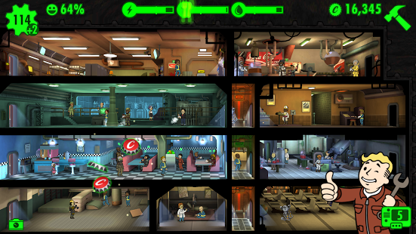
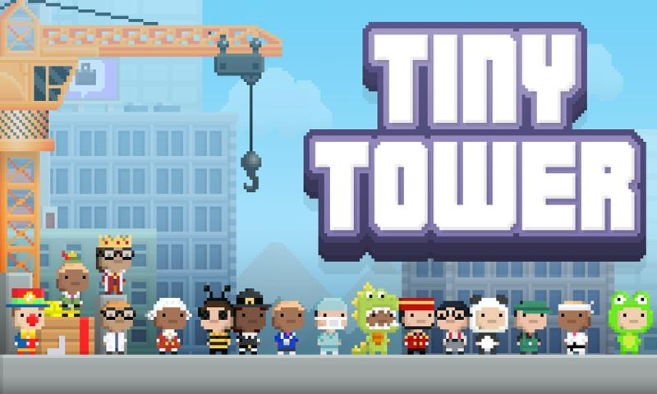
Pocket Planets: Game specification
Projected Demographic 16+ Students and Working Commuters
Casual & Achieving Players (Bartle, 1996)
Genre Managerial
Idle
Platform Android, IOS
Similar Titles

Slide 3
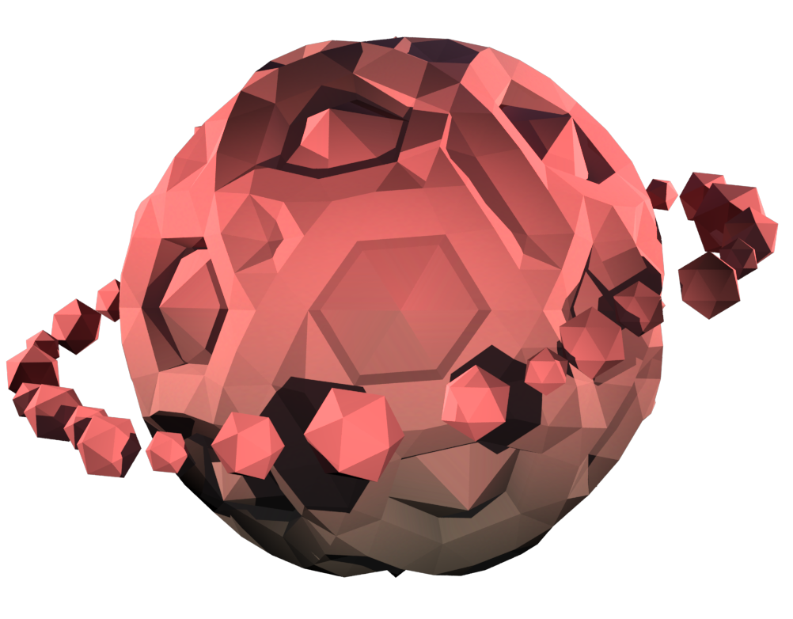
Video Footage

Slide 4
Iterations
Heavier focus on rewarding the player
More Progression Stages (Additional Visual Benefits)
Variety in different planet types
Refresh Button – More Playing Potential

Slide 5
Iterations
More Vanity Items
Changing Game Engines
User Friendly UI

Slide 6
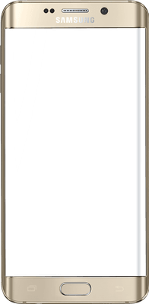
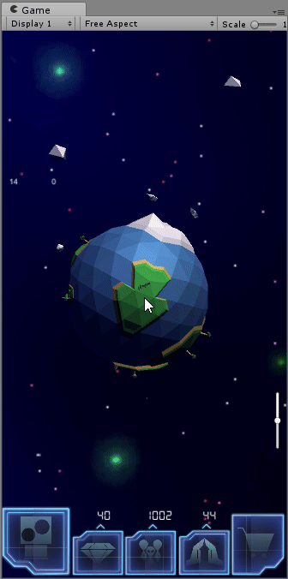
Features
Resource Management
Fling asteroids to gain wealth and lose population.
Gain population and faith overtime.
Population and Faith increases over time.
Faith grows faster when wealth and population are balanced.

Slide 7
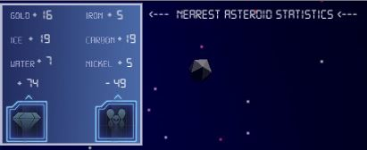
Features
Upcoming Asteroid
Shows the next incoming asteroid.
See values of incoming asteroid.
Decide ahead of time what to do with it.

Slide 8
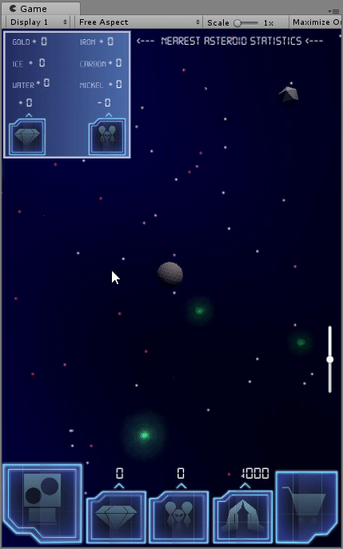
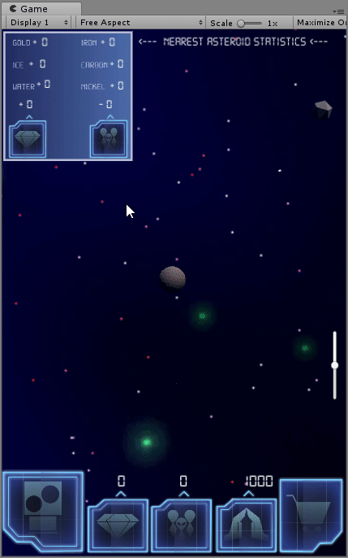
Features
Planet Forming
Different resources on asteroids used to build planet
Different Planet models to customise

Slide 9
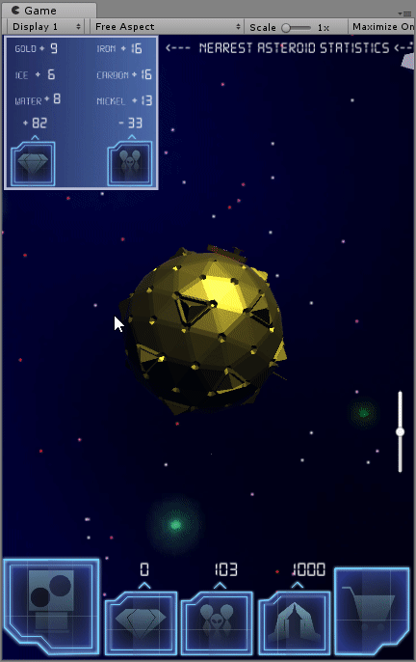
Features
Store/Gacha
Spend Faith to recieve a random vanity item
Buy cosmic dust with real money to buy specific items
Customize the planet with vanity items

Slide 10
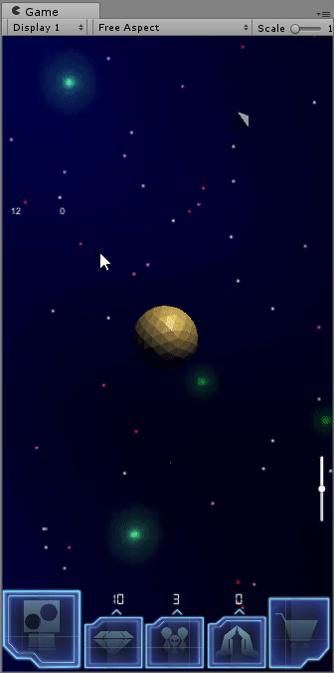
Features
Refresh
Once the planet has enough faith, the refresh ability is enabled.
A new planet is gained.
Vanity items will be reserved for futher use.
A permenant boost will be added to the population growth.
This can be done several times.

Slide 11
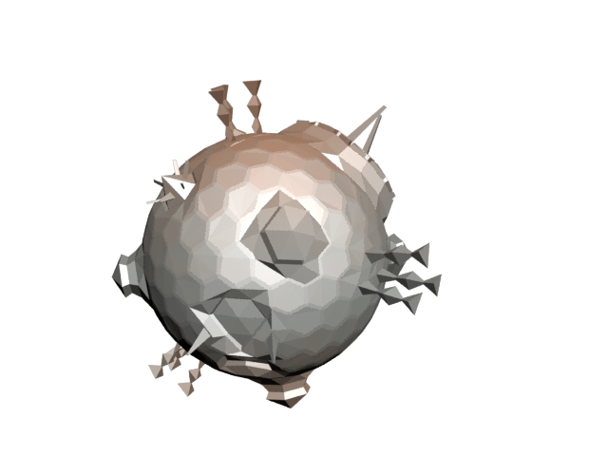
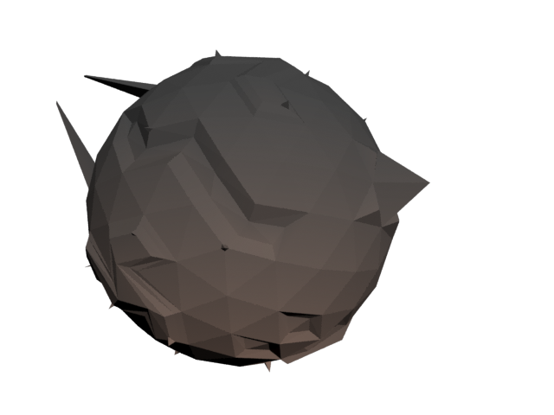
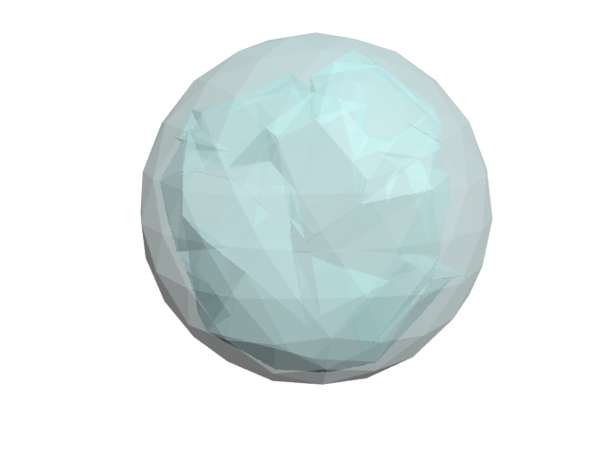
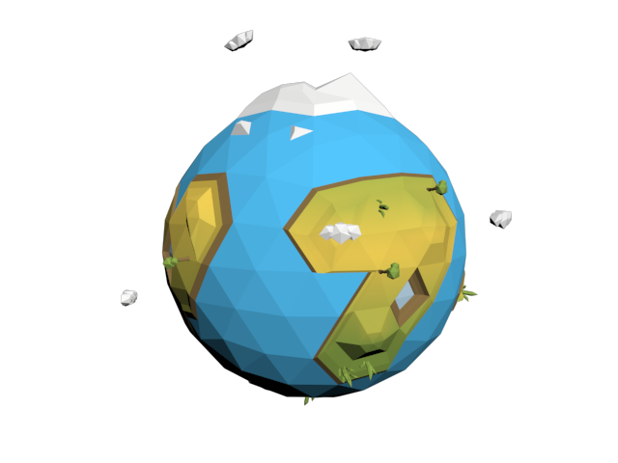
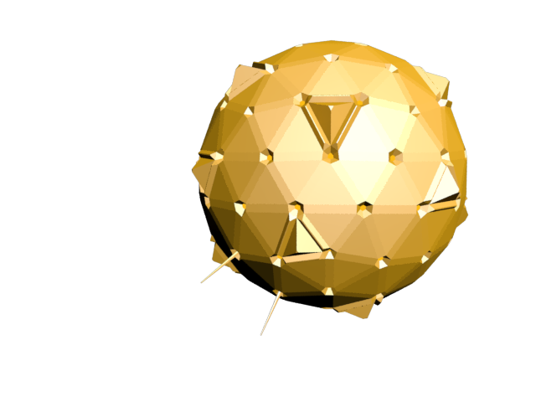
3d Models

Slide 12

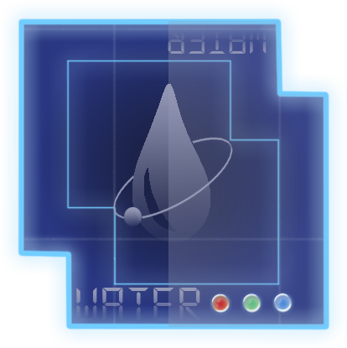
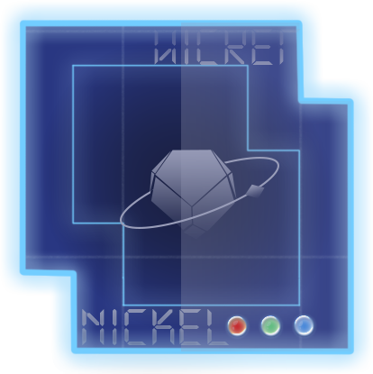
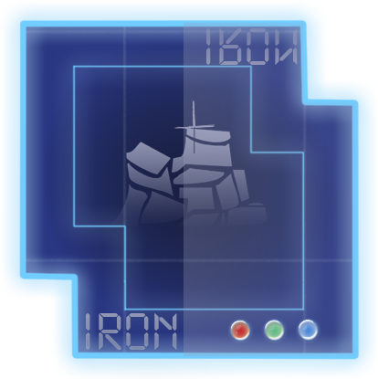
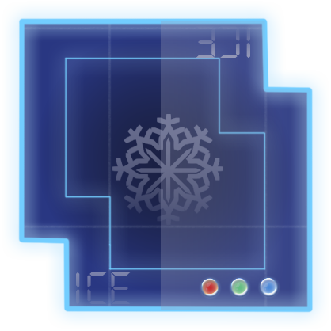

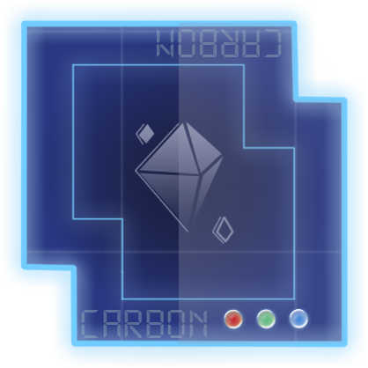






Game UI

Slide 13
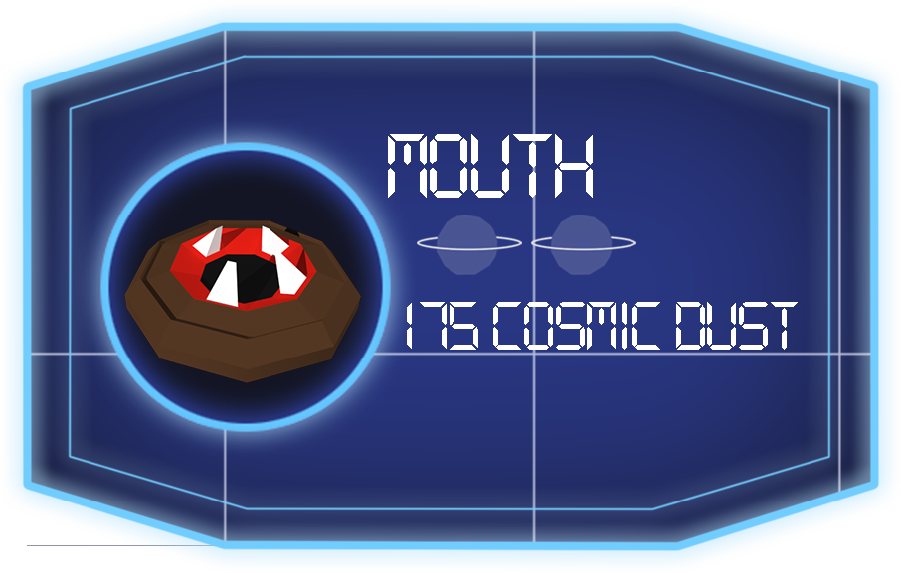
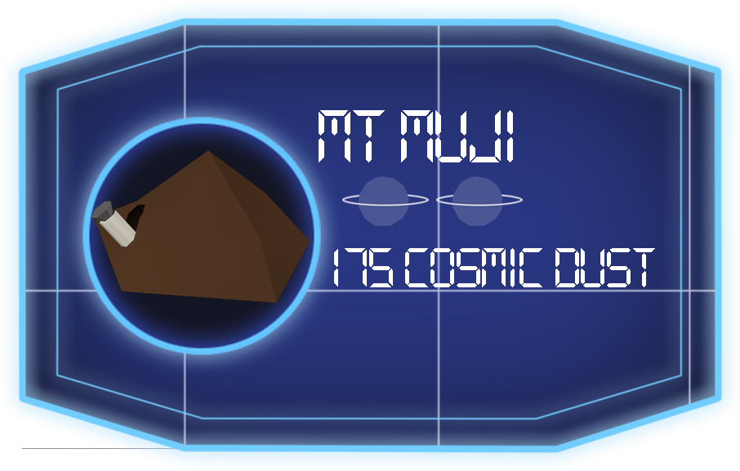
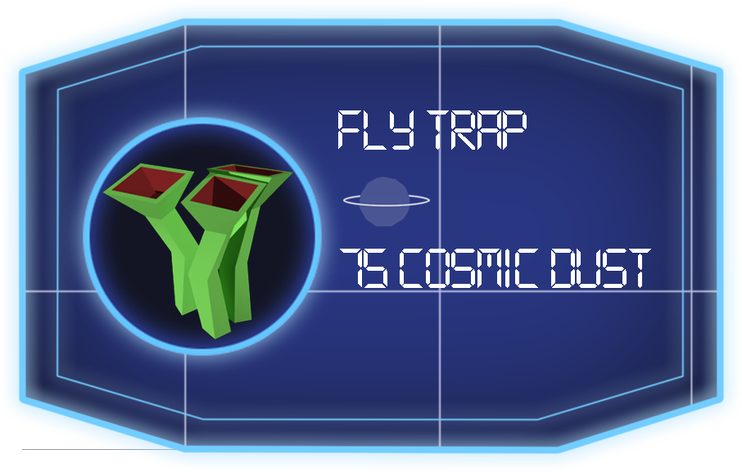
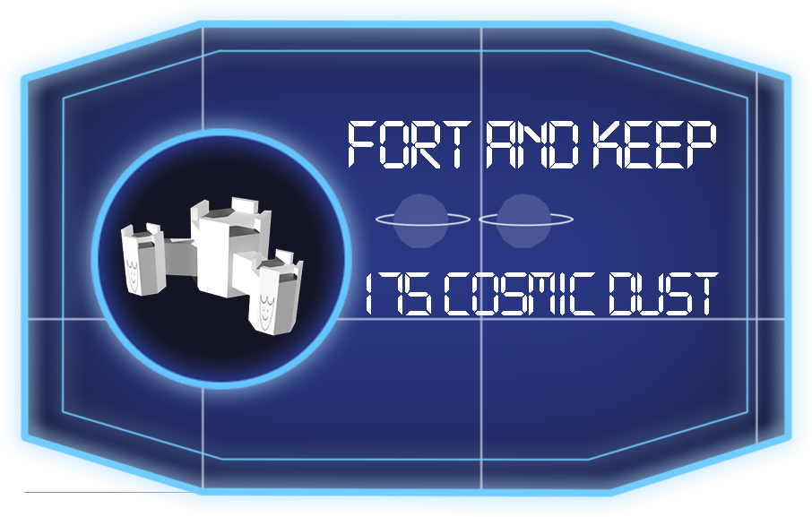




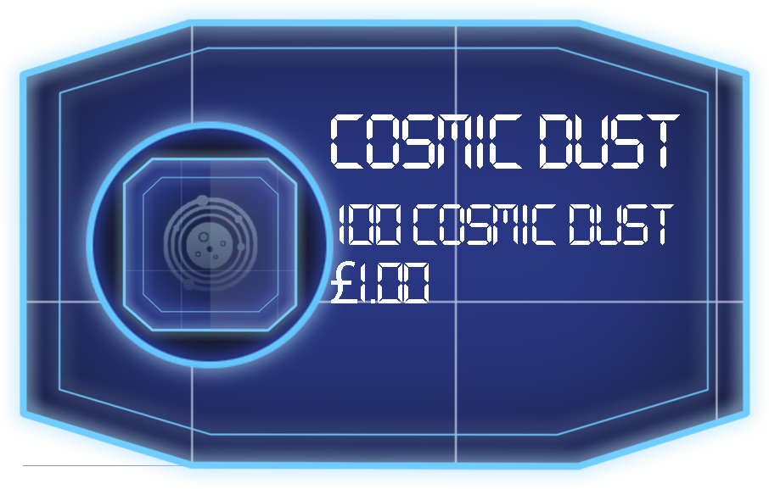

Store UI

Slide 14
Management – Hours Worked
According to Project Pivot Report (May 2017 – May 2018)
Collective: 10w 1h 19m
River: 2w 4d 1h 2m
Michael: 3w 5h 25m
Ogheneochuko: 2w 2d 1h 22m
Ryan: 1w 3d 1h 30m

